Slide 1
Arduino Analog & Sensing!

Slide 2
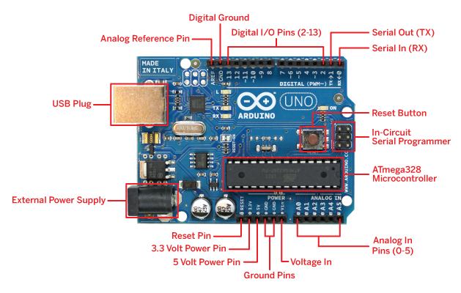
RECAP

Slide 3
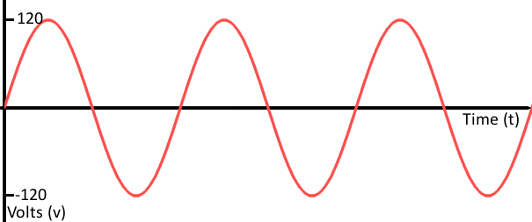
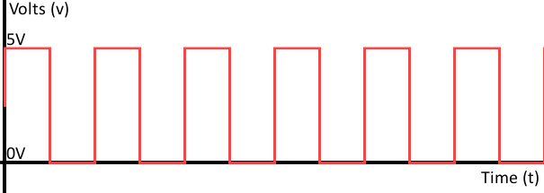
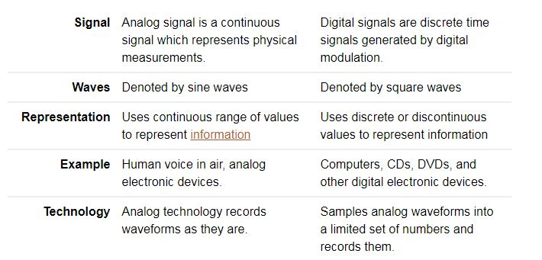
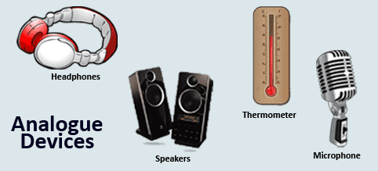

ANALOG
DIGITAL
Credits: https://www.diffen.com/difference/Analog_vs_Digital

Slide 4
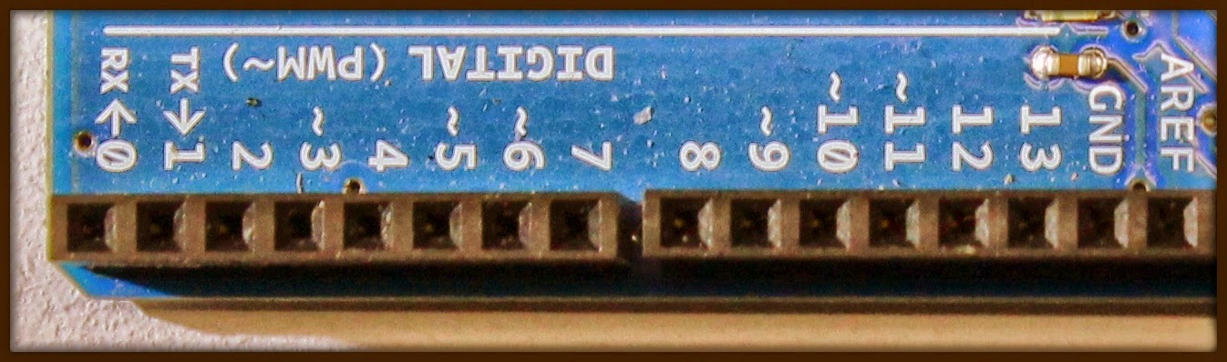
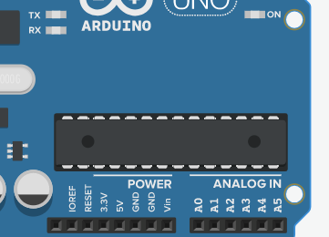
Digital pins
Onboard 6 channel analog-to-digital (A/D) converter.
ARef: On this pin, user defined reference value of ADC is given (Not more than 5 Volt).
On board 14 Digital Pins are present
Generally, provides only two kinds of output i.e.
High = 5 Volt = 1
Low = 0 Volt = 0
Analog pins

Slide 5
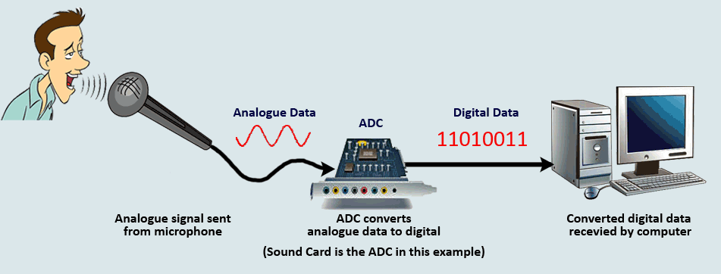
Analog to Digital Converter(ADC)

Slide 6
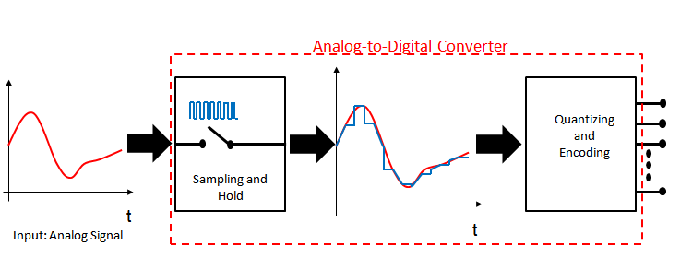
ADC process
Two main steps of the process
1.Sampling and Holding
2.Quantization and Encoding

Slide 7
Quantizing
The number of possible states that the converter can output is: N=2^{n} (n is the number of bits in the AD converter)
Example: For a 3 bit A/D converter, N=2³=8.
Analog quantization size:
Q=(V_{max}- V_{min})/N = (10 V – 0 V)/8 = 1.25V
Encoding
Here we assign the digital value (binary number) to each
state for the computer to read.
Output States Output Binary Equivalent
0 000
1 001
2 010
3 011
4 100
5 101
6 110
7 111
7 8.75-10.0

Slide 8
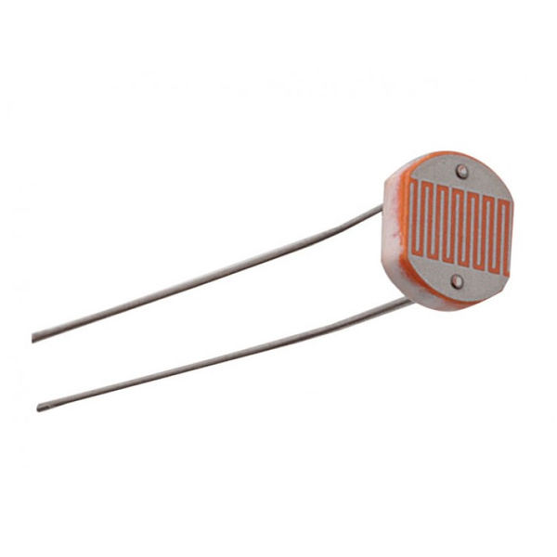
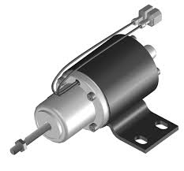
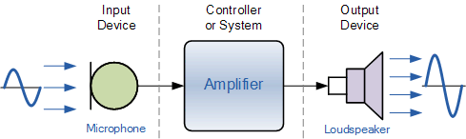
Sensing
Transduction
Actuation
Detects and responds to some type of input from the physical environment
Converting one form of energy to another
To put into motion or action

Slide 9
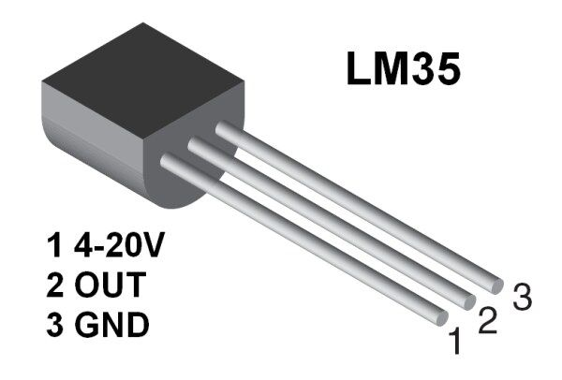
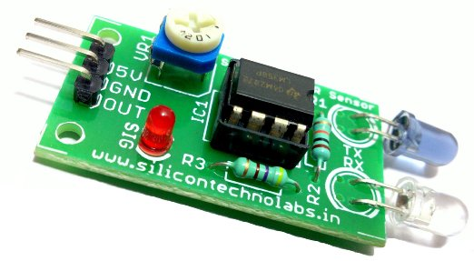
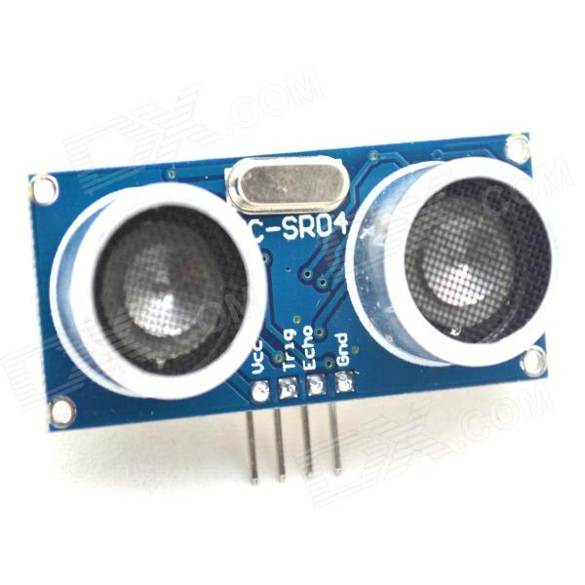
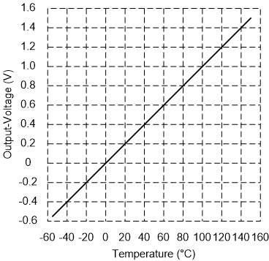
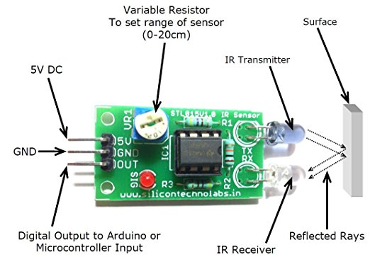
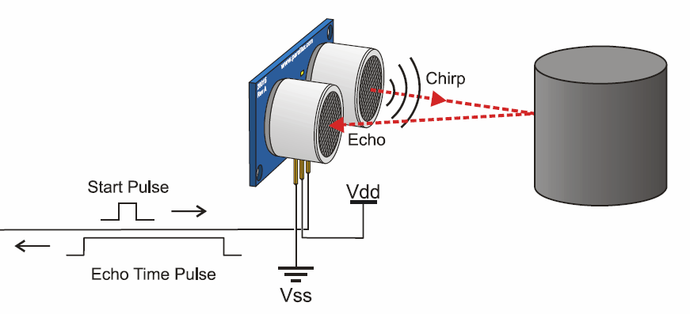
Types of Sensors
Temperature sensor(LM35) IR Sensor Ultrasonic sensor
For more sensors click here

Slide 10

Count the sensors

Slide 11
Classifications of Sensing
Direct and hybrid transduction
Absolute and relative
Active and passive
Intrinsic and extrinsic
Contact and noncontact

Slide 12
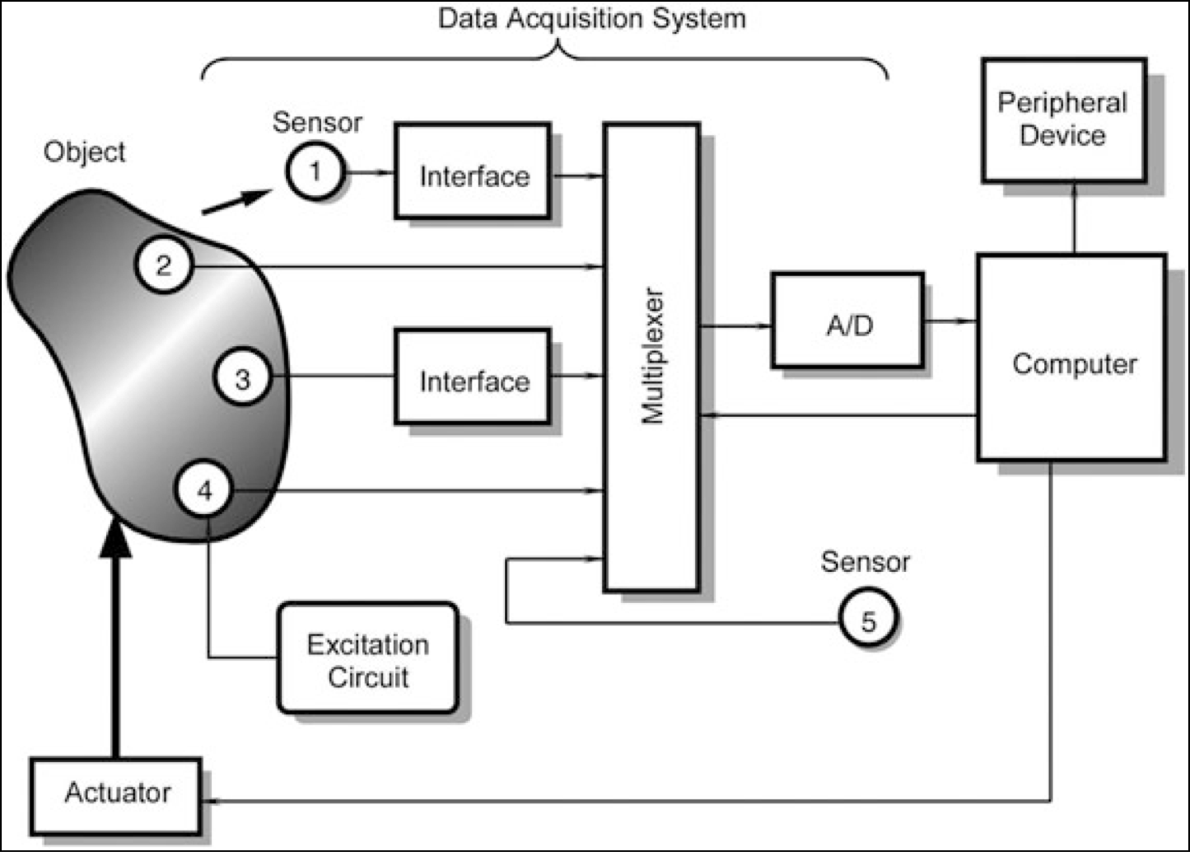
Data Acquisition System
http://www.kelm.ftn.uns.ac.rs/literatura/si/pdf/HandbookOfModernSensorsPhysicsDesignAndApplications.pdf
Notes:
To illustrate the place of sensors in a larger system, Fig. 1.3 shows a block diagram of a data acquisition and control device. An object can be anything: a car, space ship, animal or human, liquid, or gas. Any material object may become a subject of some kind of a measurement or control. Data are collected from an object by a number of sensors. Some of them (2, 3, and 4) are positioned directly on or inside the object.
Sensor 1 perceives the object without a physical contact and, therefore, is called a noncontact sensor. Examples of such a sensor is a radiation detector and a TV camera. Even if we say “noncontact”, we remember that energy transfer always occurs between a sensor and object.
Sensor 5 serves a different purpose. It monitors the internal conditions of the data acquisition system itself.
Some sensors (1 and 3) cannot be directly connected to standard electronic circuits because of the inappropriate output signal formats. They require the use of interface devices (signal conditioners) to produce a specific output format.
Sensors 1, 2, 3, and 5 are passive. They generate electric signals without energy consumption from the electronic circuits. Sensor 4 is active. It requires an operating signal that is provided by an excitation circuit. This signal is modified by the sensor or modulated by the object’s stimulus. An example of an active sensor is a thermistor that is a temperature-sensitive resistor. It needs a current source, which is an excitation circuit. Depending on the complexity of the system, the total number of sensors may vary from as little as one (a home thermostat) to many thousands (a space station).
Electrical signals from the sensors are fed into a multiplexer (MUX), which is a switch or a gate. Its function is to connect the sensors, one at a time, to an analog- to-digital converter (A/D or ADC) if a sensor produces an analog signal, or directly to a computer if a sensor produces signals in a digital format. The computer controls a multiplexer and ADC for the appropriate timing. Also, it may send control signals to an actuator that acts on the object. Examples of the actuators are an electric motor, a solenoid, a relay, and a pneumatic valve. The system contains some peripheral devices (for instance, a data recorder, display, alarm, etc.) and a number of components that are not shown in the block diagram. These may be filters, sample-and-hold circuits, amplifiers, and so forth.

Slide 13
Analog Commands on Arduino
SENSING
digitalRead() works on all pins. It will just round the analog value received and present it to you. If analogRead(A0) is greater than or equal to 512, digitalRead(A0)will be 1, else 0.
analogRead() works only on analog pins. It can take any value between 0 and 1023.
ACTUATION
digitalWrite() works on all pins, with allowed parameter 0 or 1. digitalWrite(A0,0) is the same as analogWrite(A0,0), and digitalWrite(A0,1) is the same as analogWrite(A0,255)
analogWrite() works on all analog pins and all digital PWM pins. You can supply it any value between 0 and 255.

Slide 14
Activity-1
Control LED blinking using Potentiometer

Slide 15
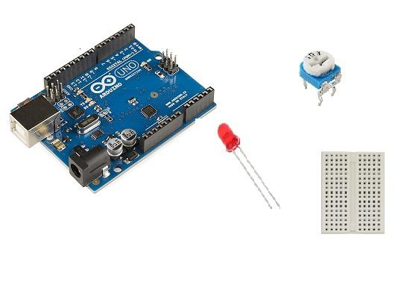
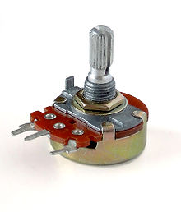
Step 1: What You Will Need
Arduino Uno
Potentiometer
Breadboard
LED
Connecting wires

Slide 16
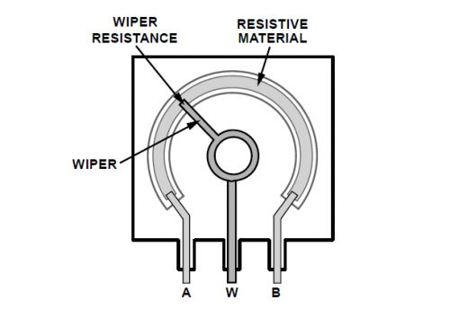
Potentiometer Black Box

Slide 17
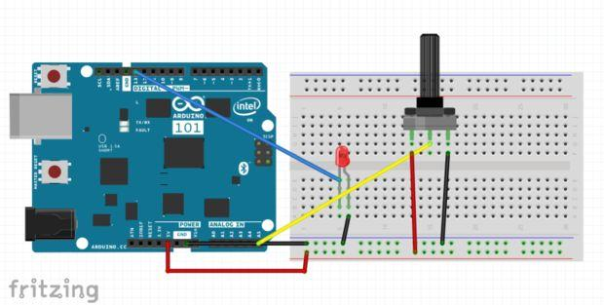
Step 2: Circuit

Slide 18
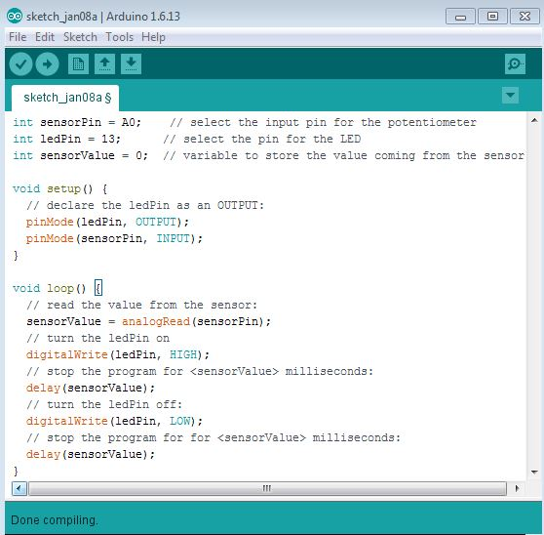
Step 3: IDE Code

Slide 19
Activity-2
Control LED with a Light-Dependent Resistor (LDR)

Slide 20
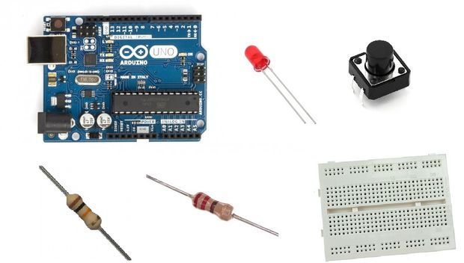

Step 1: What You Will Need
An Arduino Uno
LDR
Breadboard
10K resistor
Connecting wires
LED
22O Ohm Resistor

Slide 21
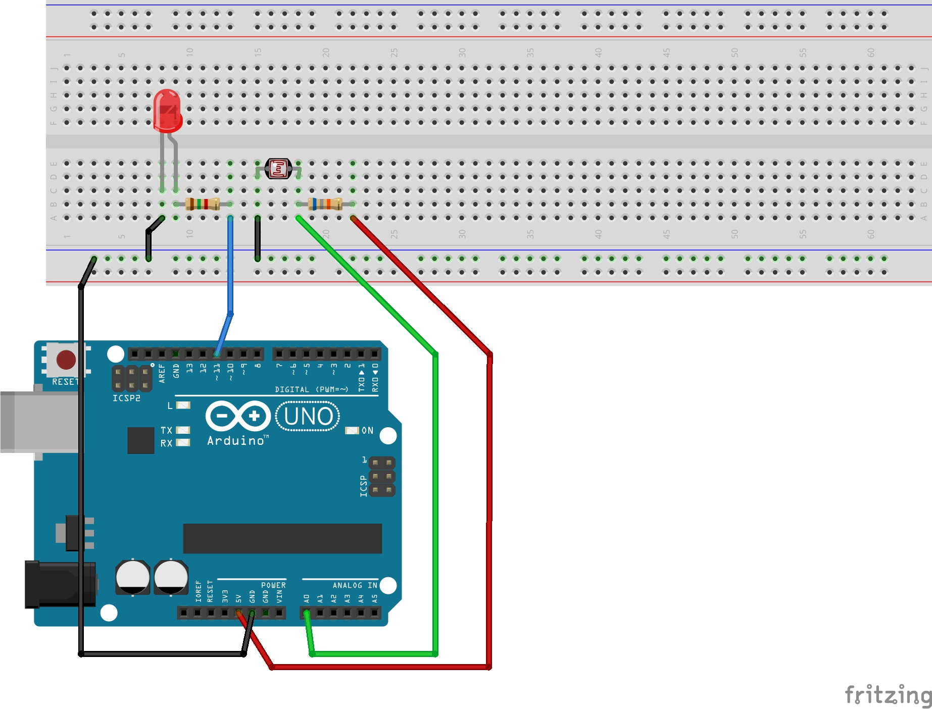
Step 2: Circuit

Slide 22
const int ledPin = 13;
const int ldrPin = A0;
void setup() {
Serial.begin(9600);
pinMode(ledPin, OUTPUT);
pinMode(ldrPin, INPUT);
}
void loop() {
int ldrStatus = analogRead(ldrPin);
if (ldrStatus <=300) {
digitalWrite(ledPin, HIGH);
Serial.println("LDR is DARK, LED is ON");
delay (500);
} else {
digitalWrite(ledPin, LOW);
Serial.println("---------------");
delay (500);
}
}
Step 3: IDE Code

Slide 23
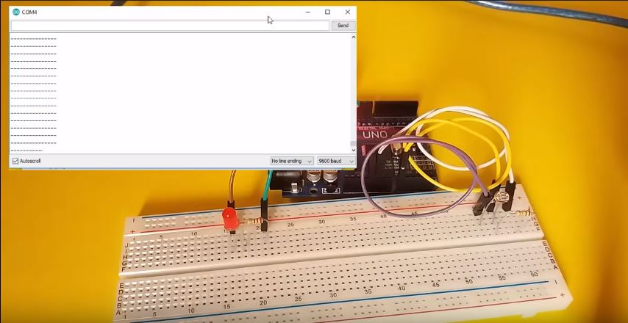
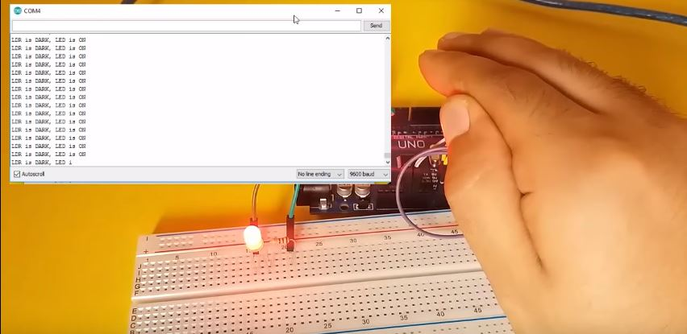
Expected Outcome
https://www.youtube.com/watch?v=4fN1aJMH9mM

